Slide 1
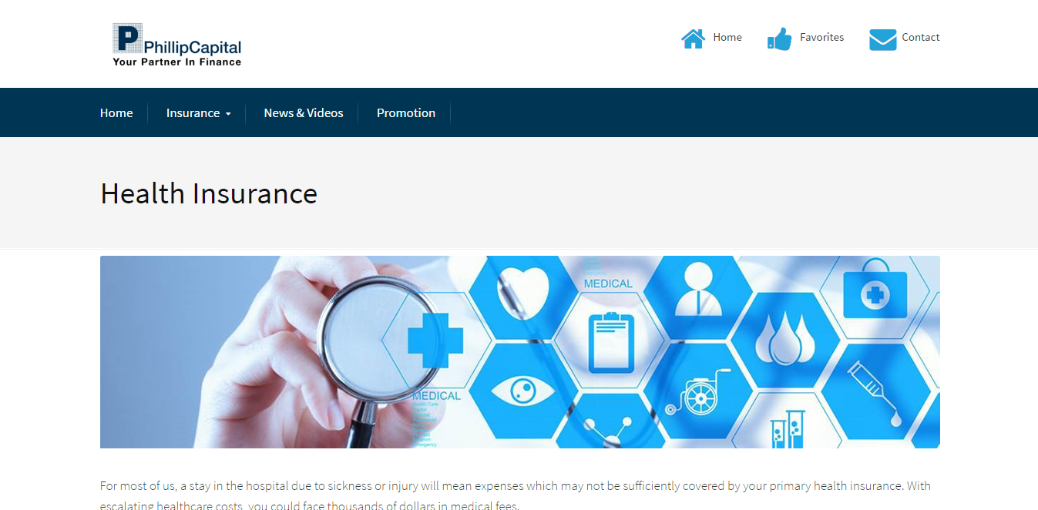
Calculators
Reduce size to 3/4
Remove paragraph.

Slide 2

Check out the CPF Medisave-approved policies below!
Medisave can be used to pay premiums for approved medical insurance schemes like MediShield for yourself and your dependents. If you prefer higher coverage for your medical treatment expenses, you can use your Medisave to buy an enhancement plan from an approved private insurer. These enhanced plans, called Integrated Shield Plans are integrated with MediShield to provide financial protection on top of what MediShield provides.

Slide 3
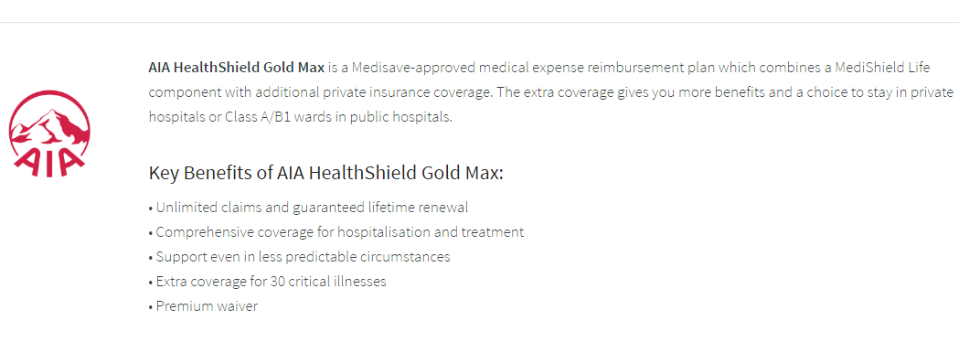
Enquire Now!
Learn More
Opens up “AIA healthshield goldmax” PDF as a separate tab.
Once clicked, opens enquiry page

Slide 4
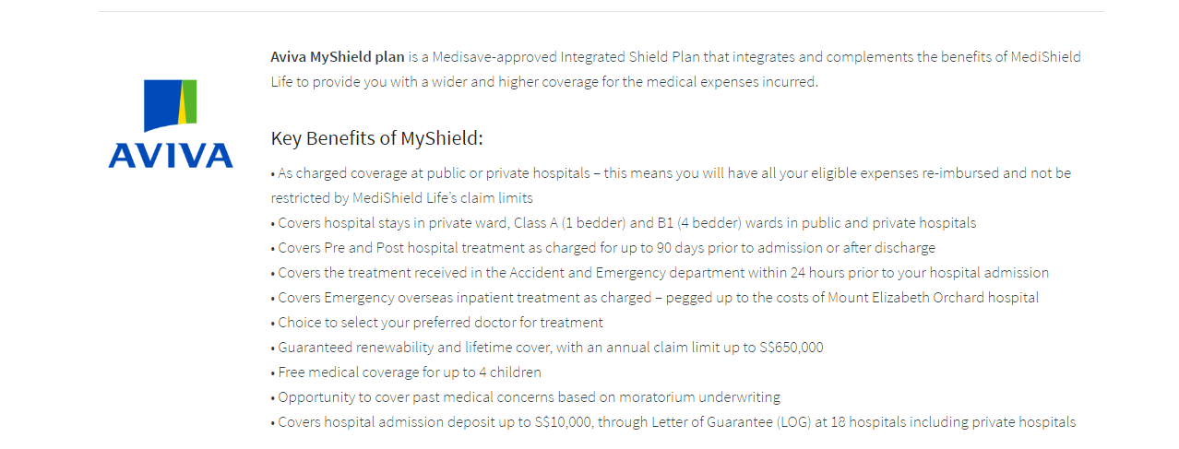
Enquire Now!
Learn More
Once clicked, opens enquiry page
Opens up “AVIVA MyShield n MyHealthPlus” PDF as a separate tab.

Slide 5
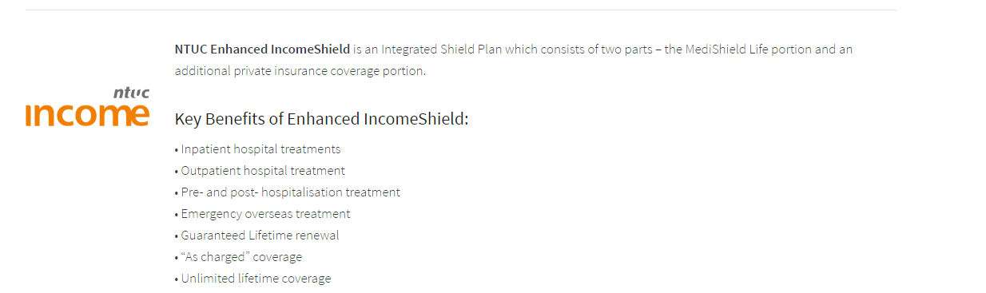
Enquire Now!
Learn More
Opens up “NTUC Enhanced IncomeShield” PDF as a separate tab.
Once clicked, opens enquiry page

Slide 6

ENQUIRY
Fill up the form below and our dedicated staff will contact you within 2 business days.
Product*
First Name*
Family Name*
Gender*
Date of Birth (dd/mm/yyyy)*
Best time to be contacted
Morning
x
DD
/
Afternoon
MM
/
YYYY
Don’t worry. We do not sell your particulars or contact details.
Email*
Contact number*
?
Any other requirements or consideration which you might have, so that we can serve you better.
*Compulsory fields
I have read the and agree to the site’s Privacy and security policy.
Links to site’s privacy policy page (opens separate tab). .
Submit

Slide 7
Once enquiry form is submitted
Thank You
Your enquiry has been sent. Look out for our reply within two business days!
Back end: Once submitted, email will be sent to talktophillip@phillip.com.sg in the following format (example):
Product
First name
Family name
Gender
Date of birth
Best time to be contacted
Email
Contact number
Other considerations
AIA HealthShield Gold Max
Jason
Lee
Male
9 August 1943
Afternoon
jasonlee@gmail.com
91234567
NIL

Slide 8
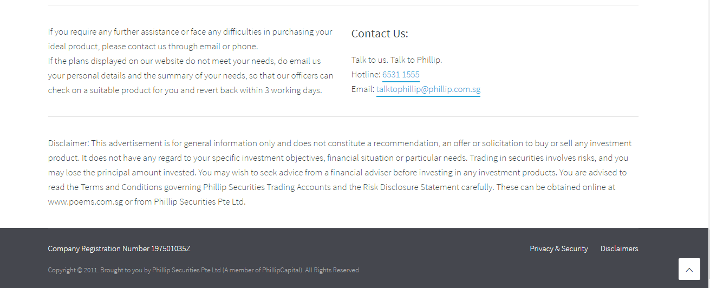
Follow this footer for all existing pages. 2011 change to 2016.
Privacy & security policy and disclaimers as attached. Please create separate pages for these two links.

